Slide 1
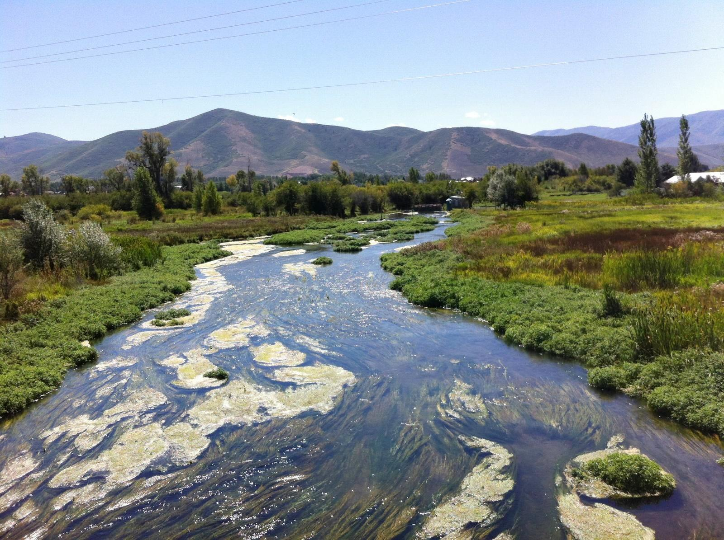
Ecological Responses to Nutrients
Snake Creek, Heber Valley, 2014
Utah Division of Water Quality

Slide 2
Discussion Overview
Review of Ecological Indicators
Application of Ecological Responses
Overview of Associated Documents
Technical Basis: Ecological Indicators
Headwater Numeric Criteria Rationale

Slide 3
Regional Numeric Nutrient Criteria
Two Analytical Methods
Distribution of Reference Site Concentrations
Base criteria on pre-defined percentiles
Assumes that background concentrations are reasonable (no direct tie to biological condition)
But, also that reference sites are too high
Stressor-Response Models
Relate nutrient concentrations to biological responses
Derive statistical thresholds
Confirm ecological relevance of thresholds
But, cannot really ascribe cause-effect at regional scales

Slide 4
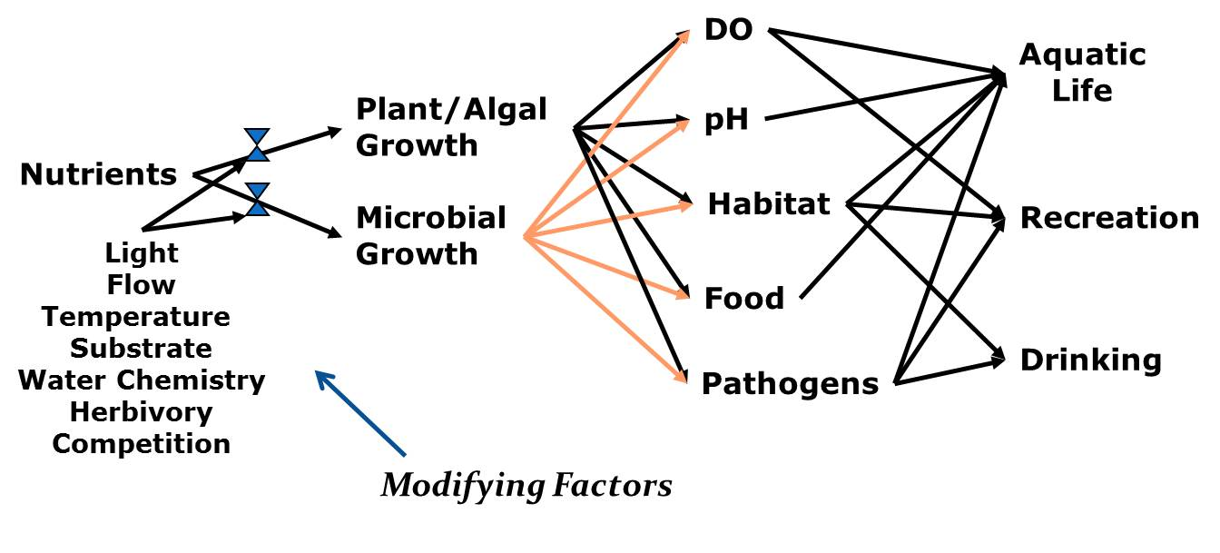
Nutrient Responses are Complex
Notes:
Make sure to point out:
two biological assemblages (important later)
The arrows from each go to multiple potential responses, some of which (i.e., habitat, food, pathogens) are themselves fairly complex.
Modifying factors can affect the magnitude of the responses
Ultimate result is that it is difficult to predict, from nutrients alone, what effects might occur

Slide 5
Multiple Lines of Evidence
Ecosystem Function
Origins in Ecosystem Ecology
Bridge physical and biological
Indicators describe important properties:
Hydrology & Chemistry
Nutrient Limitation
Nutrient Saturation
Organic Matter Storage
or processes:
Production
Respiration
Ecosystem Structure
Biological Endpoints
Typically composition and relative abundance of biological assemblages
Diatoms
Macroinvertebrates
Biological Assessments
An important application
In order to reach a reliable conclusion about how the world operates it is better to have multiple independent lines of evidence converging on one conclusion. That, of course, requires multiple studies. -Steven Novella

Slide 6
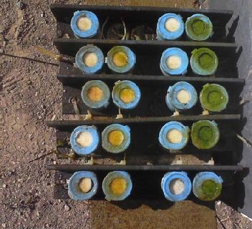
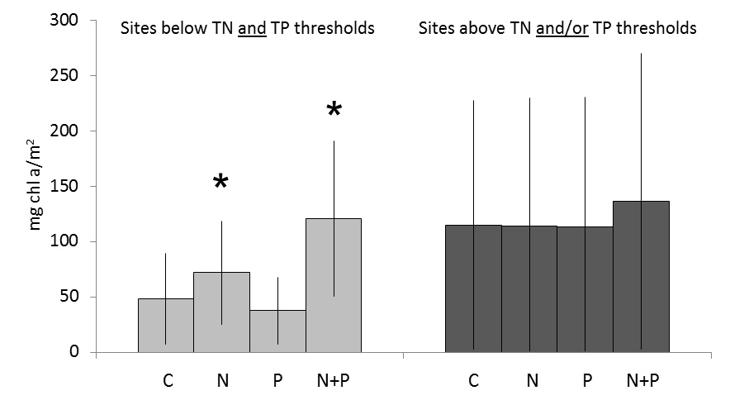
Nutrient Limitation: NDS Experiments
Estimate the relative extent of N vs. P limitation
Derive thresholds based on saturation
Saturation Thresholds
TN = 0.042 (95%: 0.33-1.41)
TP = 0.078 (95%: 0.017-1.33)
Confirmed accuracy of classifications with ROC:
TN = 82% (AUC)
TP = 72%

Slide 7
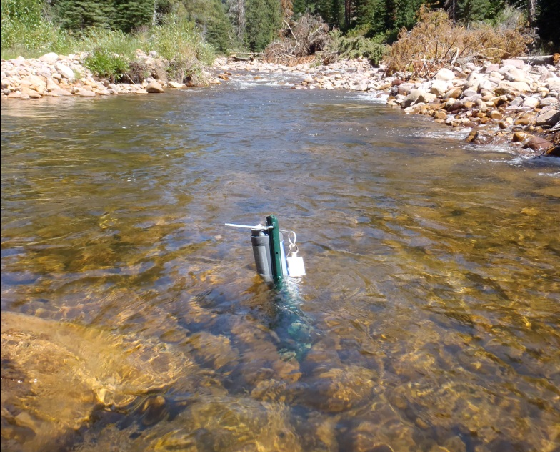
Whole Stream Metabolism
∆DO = GPP – CR ± E
Use oxygen to measure two fundamental ecosystem processes
From Odum, 1950s
Production
Fix Carbon
Produce Oxygen
Community Respiration
Consume Carbon
Consume Oxygen
Dissolved Oxygen
Time

Slide 8
Whole Stream Metabolism
Nutrient
Nutrient Group Thresholds
TN (mg/L) Low < 0.24 > Medium < 1.28 > High
TP (mg/L) Low < 0.02 > Medium < 0.09 > High
b
c
GPP g0₂/m²/day
b
ER g0₂/m²/day
b
a
a
TN Group
TN Group
c
b
GPP g0₂/m²/day
b
ER g0₂/m²/day
a
a
b
TP Group
TP Group

Slide 9
Confirmation of Ecological Significance

Slide 10
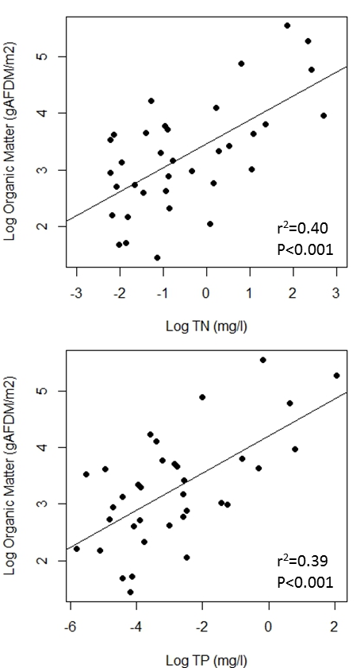
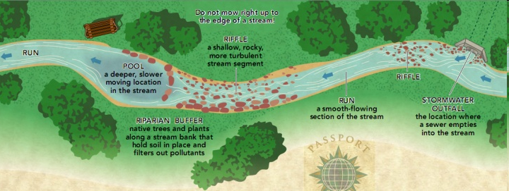
Organic Matter Standing Stocks
Reach-scale estimates of the amount of carbon produced in streams
Figure 5.1. Linear regression between surface water total nitrogen (A, r²=0.40, p<0.001) and total phosphorus (B, r²=0.39, p<0.001) and AFDM (g/m²).

Slide 11
Organic Matter Standing Stocks
Developed estimates of excess carbon storage
Related these thresholds to DO numeric criteria

Slide 12
Structural Responses: TITAN
Evaluate taxa that change predictably with nutrients
Develop thresholds based on concentrations where changes are most pronounced
Models were developed for diatoms (algae) and macroinvertebrates (bugs)
SumZ (-)
SumZ (+)

Slide 13
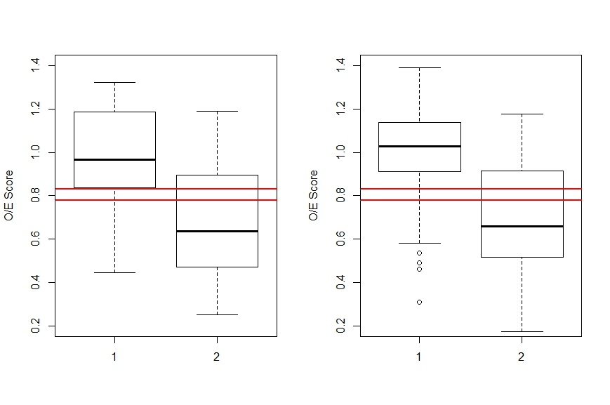
Relate to Biological Assessments
O/E
<0.433
>0.433
<0.045
>0.045
TN mg/L
TP mg/L

Slide 14
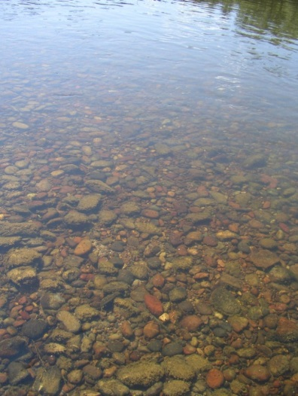
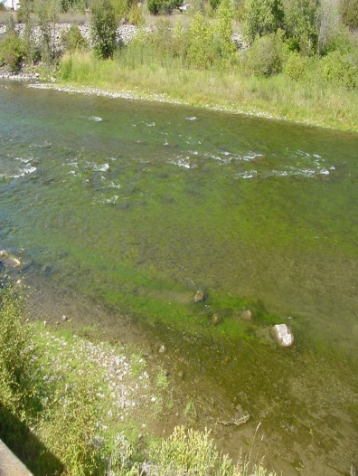
Recreation Uses
96.6
92.4
A
Survey asked,
“For each photograph on the insert tell us if the level of algae would be desirable or undesirable for YOUR most common uses of rivers, if any. There are no correct answers; this is your opinion only. Fill in one bubble for each number.”
59.8
29.3
17.5
13.8
14.2
7.8
B
= Users (~3/4 of Utahns)
= Non-Users

Slide 15
Phosphorus
Fish (literature^{F})
0.14
Macroinvertebrates (literature^{M})
0.15
Benchmarks
Nuisance Algae Control (literature^{A})
CO & MT Proposed NNC
Region 8 Investigations (literature^{D}, n=11)
Distribution Methods
Western Mountain Reference Sites (UDWQ)
Biological Assessments: O/E ^{S-R}
TITAN – Macroinvertebrates ^{S-R}
Structural Responses
TITAN – Diatoms ^{S-R}
Organic Matter ^{S-R}
Metabolism ^{S-R}
0.589
Functional Responses
Saturation ^{S-R}
1.33
0.01
0.02
0.03
0.04
0.05
0.06
0.07
0.08
0.09
0.10
0.11
Total Phosphorus (mg/l)

Slide 16
Nitrogen
Fish (literature^{F})
0.14
Macroinvertebrates (literature^{M})
0.15
Benchmarks
Nuisance Algae Control (literature^{A})
CO & MT Proposed NNC
Region 8 Investigations (literature^{D}, n=11)
Distribution Methods
Western Mountain Reference Sites (UDWQ)
Biological Assessments: O/E ^{S-R}
TITAN – Macroinvertebrates ^{S-R}
Structural Responses
TITAN – Diatoms ^{S-R}
Organic Matter ^{S-R}
Metabolism ^{S-R}
0.589
Functional Responses
Saturation ^{S-R}
1.33
0.01
0.02
0.03
0.04
0.05
0.06
0.07
0.08
0.09
0.10
0.11
Total Phosphorus (mg/l)

Slide 17
Application
At a Regional Scale
More robust assessments of nutrient-related problems
Numeric criteria for headwater streams
At a Site-Specific Scale
Inform resource prioritization
Modify indicator thresholds (water quality goals)
incorporate site-specific modifying conditions (covariates)
Develop site-specific standards
calibrate mechanistic models
provide empirical confirmation for key endpoints
Quantify remediation progress

Slide 18
Outline: Technical Basis

Slide 19
Outline: Technical Basis
Section 1: Ecosystem Functions
Section Introduction
Limitation and Saturation

Slide 20
Outline: Technical Basis
Section 1: Ecosystem Functions
Stream Metabolism
Organic Matter

Slide 21
Outline: Technical Basis
Section 2: Aquatic Life and Recreation Uses
Structural Indicators
Macroinvertebrates and Diatoms

Slide 22
Outline: Technical Basis
Section 3: Application
Headwater Streams Criteria
Site-Specific Investigations
Mechanistic Models

Slide 23
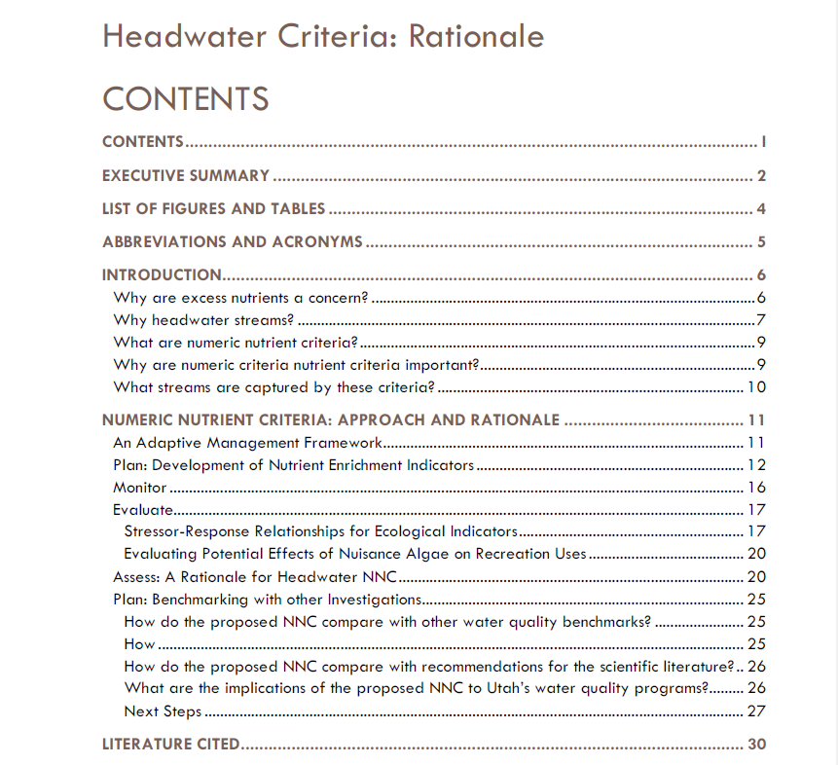
Outline: Headwater Proposal
Objectives
Summarize the proposed criteria rationale
Provide the rationale to support the numbers

Slide 24
Finalizing the Documents: Proposed Process
Technical Team: Review of Technical Material Revisions
incorporate comments
“finalize” the report
Review Headwater Proposal
Technical Team & Forest Service, then
Core Team (access to technical report provided)

